Slide 1

Puducherry Technological University
Department of Information Technology
AGRITWIN-GH: AGRICULTURAL DIGITAL TWIN FOR SMART GREENHOUSE HORTICULTURE OF TOMATO CULTIVATION
Under the Supervision of
Dr. V. Govindasamy
Professor
Department of Information Technology
Puducherry Technological University
Project By,
Mr. Arjun Christopher S (Reg No : 2201112007)
Miss. Bhuvanalakshmi J P (Reg No : 2201112009)
Miss. Vantapati Raja Rajeswari (Reg No : 2201112052)

Slide 2
Agenda
Abstract
Techniques and Algorithms Used
Literature Survey
Proposed System Architecture of AgriTwin-GH
Project Modules
Module – I: Data Processing and AI-Based Crop Intelligence
Module – II: Predictive Analytics & Crop Health Forecasting
Module – III: Digital Twin Simulation and Intelligent Greenhouse Control
Module-1 Implementation
Demonstration
Results and Performance
Datasets Used
References

Slide 3
Abstract
Greenhouse cultivation of high-value crops such as tomato is increasingly important for ensuring stable food production and improved crop quality.
Conventional greenhouse management systems rely on reactive monitoring and manual decision-making, which may lead to crop loss and excessive consumption of water, energy, and fertilizers. However, this cultivation method faces several challenges.
The proposed system AgriTwin-GH introduces a software-based AI-powered Digital Twin framework for intelligent greenhouse management.
The system utilizes environmental datasets and plant image datasets to analyze greenhouse conditions and crop health. The system enables predictive analysis of greenhouse conditions and disease risk, supporting proactive decision-making.
The framework improves crop productivity, early disease awareness, and efficient resource utilization while reducing unnecessary operational costs.
The developed AI models achieved ~98% accuracy for plant disease classification and growth stage classification, demonstrating high reliability for greenhouse crop monitoring.

Slide 4
Techniques and Algorithms Used
Convolutional Neural Networks (CNN)
Convolutional Neural Networks are specialized deep learning models designed for image recognition and computer vision applications.
The architecture consists of convolution layers, pooling layers, and fully connected layers that progressively learn visual representations of plant conditions. Convolution layers capture spatial patterns in the image, while pooling layers reduce dimensionality and improve computational efficiency.
The final classification layers use the extracted features to categorize images into specific disease or growth stage classes.
Transfer Learning
Transfer learning is a machine learning technique where a model trained on a large dataset is reused and adapted for a related task. Instead of training from scratch, the model leverages previously learned knowledge to improve performance and reduce training time.
The learned visual features from large datasets are transferred and fine-tuned using agricultural plant image datasets.
Transfer learning also improves model accuracy when the available dataset is relatively small.

Slide 5
Techniques and Algorithms Used (Contd..)
EfficientNet Architecture
EfficientNet is a modern deep learning architecture developed to achieve high image classification accuracy while maintaining strong computational efficiency.
It was designed to improve the performance of convolutional neural networks while reducing the number of parameters and computational resources required for training.
EfficientNet models have demonstrated strong performance in many image classification tasks. Their ability to capture detailed visual patterns makes them particularly suitable for applications involving complex image data.
Image Data Augmentation
Image data augmentation is a deep learning technique that increases the size and diversity of a dataset by applying transformations to existing images. It generates new variations of the data without collecting additional images, helping improve model training and robustness.
Augmentation introduces variations that simulate real-world imaging conditions.
This helps the deep learning model learn robust visual features and reduces the risk of overfitting.

Slide 6
Literature Survey
S. No. | Title of Paper | Journal Title with Year of Publication & Author | Technical Description | Research Gap
1 | Optimizing Agricultural Data Analysis Techniques Through AI-Powered Decision-Making Processes | Elbasi, E., Mostafa, N., Zaki, C., AlArnaout, Z., Topcu, A. E., & Saker, L. Applied Sciences, Vol. 14, 2024. | The study focuses on preprocessing techniques for agricultural datasets including noise removal, dataset balancing, feature selection, and dimensionality reduction to improve machine learning model performance. | Focuses only on agricultural data preprocessing and does not address plant disease detection or greenhouse monitoring systems.
2 | Plant Leaf Disease Detection Using Ensemble Learning and Explainable Artificial Intelligence | Oad, A., Abbas, S. S., Zafar, A., et al. IEEE Access, Vol. 12, 2024. | Proposes an ensemble deep learning framework using CNN architectures such as VGG16, VGG19, InceptionV3, and ResNet101V2 for plant leaf disease classification using the PlantVillage dataset. | The system performs only disease classification and does not integrate environmental monitoring or crop growth prediction in greenhouse environments.
3 | Identifying Tomato Growth Stages in Protected Agriculture with StyleGAN3-Synthetic Images and Vision Transformer | Huo, Y., Liu, Y., He, P., Hu, L., Gao, W., & Gu, L. Agriculture, Vol. 15, Article 120, 2025. | Introduces a hybrid deep learning framework combining StyleGAN3 for synthetic image generation and Vision Transformer for accurate tomato growth stage recognition. | The study focuses only on growth stage identification and does not incorporate disease detection or integrated digital twin greenhouse management.

Slide 7
Proposed System Architecture of AgriTwin-GH
The AgriTwin-GH system architecture is designed to integrate environmental datasets and plant image data to enable intelligent greenhouse monitoring and predictive crop analysis.
Input:
Environmental dataset (temperature, humidity, solar radiation, wind speed, etc.,)
Tomato plant image dataset for disease detection and growth stage analysis
Processing:
Module – I : Data Processing and AI-Based Crop Intelligence
Module – II : Predictive Analytics and Crop Health Forecasting Analyzes
Module – III : Digital Twin Simulation and Intelligent Greenhouse Control
Output:
Provides a unified assessment of plant health and disease likelihood.
Identifies current crop developmental stage.
Signals optimal harvest timing.
Improved resource optimization through predictive simulation.

Slide 8
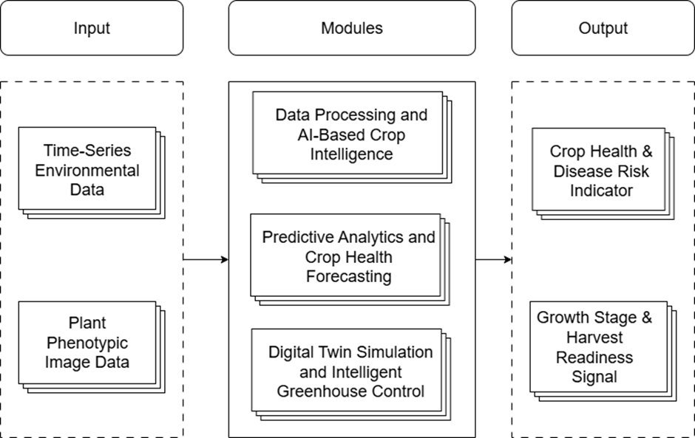
Proposed System Architecture of AgriTwin-GH (Contd..)
Fig: High-Level Architecture Diagram of AgriTwin-GH

Slide 9
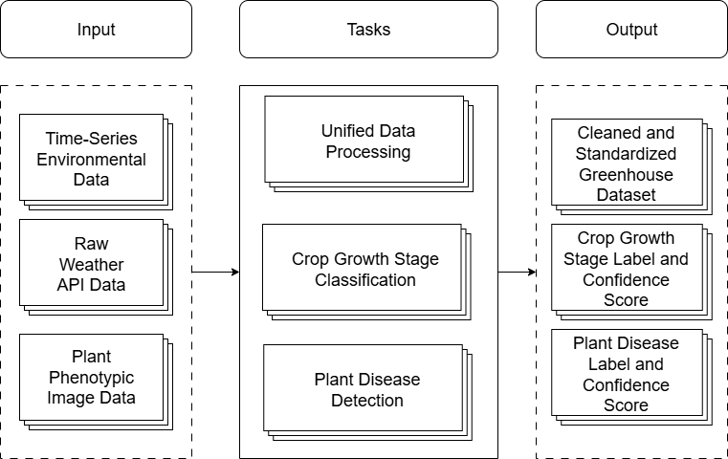
Project Modules
Module – I: Data Processing and AI-Based Crop Intelligence
This module focuses on preparing agricultural datasets and analyzing crop conditions.
Processes environmental datasets obtained from weather API.
Performs data cleaning, validation, and feature engineering.
Preprocesses plant image datasets for AI analysis.
Uses deep learning models for plant disease detection and crop growth stage classification.
Fig. Task-Level Architecture of Data Processing and AI-Based Crop Intelligence Module

Slide 10
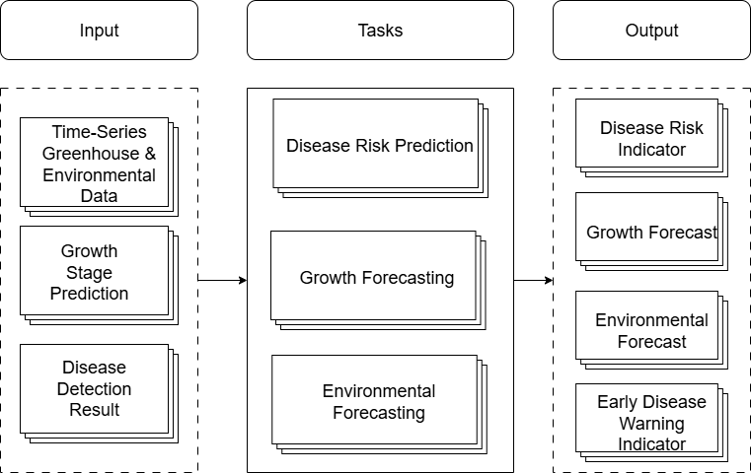
Project Modules (Contd..)
Module – II: Predictive Analytics & Crop Health Forecasting
This module predicts future crop and environmental conditions.
Analyzes greenhouse environmental data and crop analysis outputs.
Performs disease risk prediction using environmental factor.
Forecasts crop growth progression using temporal data.
Predicts future greenhouse environmental conditions.
Fig . Task-Level Architecture of Predictive Analytics and Crop Health Forecasting Module

Slide 11
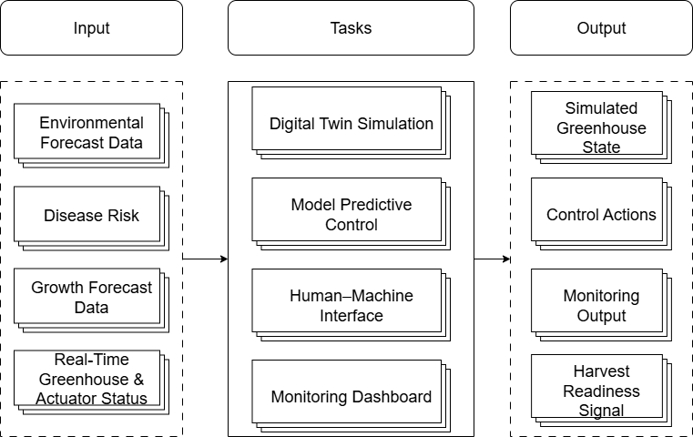
Project Modules (Contd..)
Module – III: Digital Twin Simulation and Intelligent Greenhouse Control
This module implements the digital twin model of the greenhouse.
Creates a virtual representation of greenhouse conditions. Simulates crop growth and environmental dynamic.
Evaluates alternative climate control strategies.
Provides decision-support insights for greenhouse management.
Fig. Task-Level Architecture of Digital Twin Simulation and Intelligent Greenhouse Control Module

Slide 12
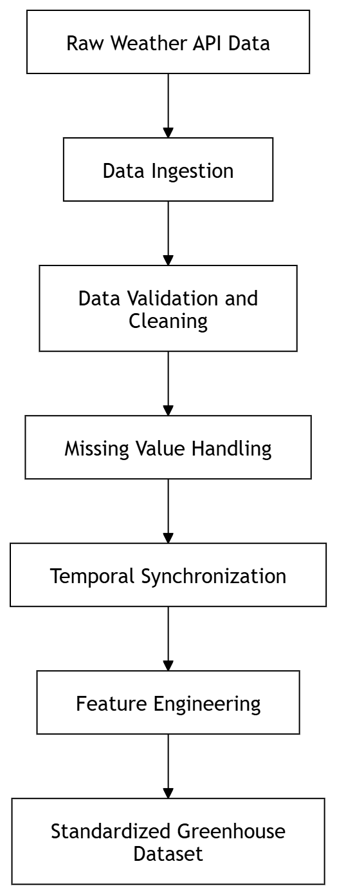
Module-1 Implementation
Unified Data Processing Pipeline
Environmental datasets collected from weather API.
Raw datasets undergo data cleaning and validation to remove inconsistencies.
Missing values and noisy data are handled using data preprocessing techniques.
Feature engineering derives important greenhouse parameters such as:
Indoor temperature
Indoor humidity
CO₂ concentration
Vapor Pressure Deficit (VPD)
Processed environmental data becomes standardized greenhouse dataset.
Image datasets are processed through deep learning models for crop analysis.
Fig. Data Processing Pipeline Architecture

Slide 13
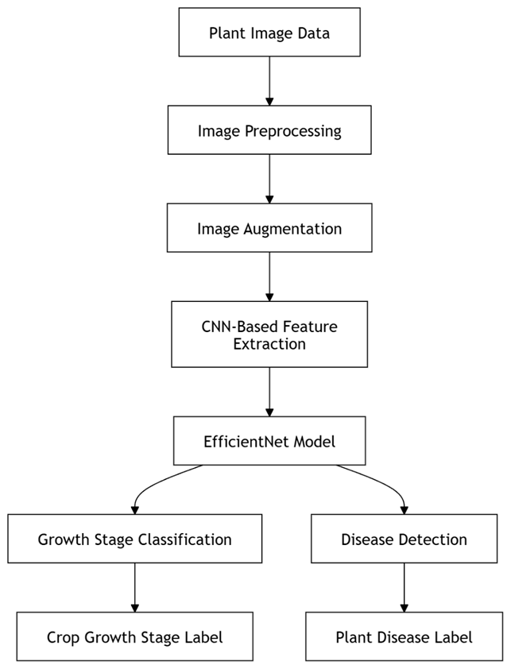
Module-1 Implementation (Contd..)
AI-Based Crop Intelligence Workflow
Plant image datasets are used as input for crop analysis.
Images are first processed through image preprocessing and augmentation.
Augmentation techniques include rotation, flipping, zooming, and brightness adjustment.
A CNN-based feature extraction process identifies important visual patterns in plant images.
The extracted features are passed to the EfficientNet deep learning model.
The model performs two classification tasks:
Plant disease detection
Crop growth stage classification
The system generates outputs including:
Disease prediction label
Growth stage prediction
Confidence scores for predictions
Fig. Growth Stage Classification and Disease Detection Workflow

Slide 14
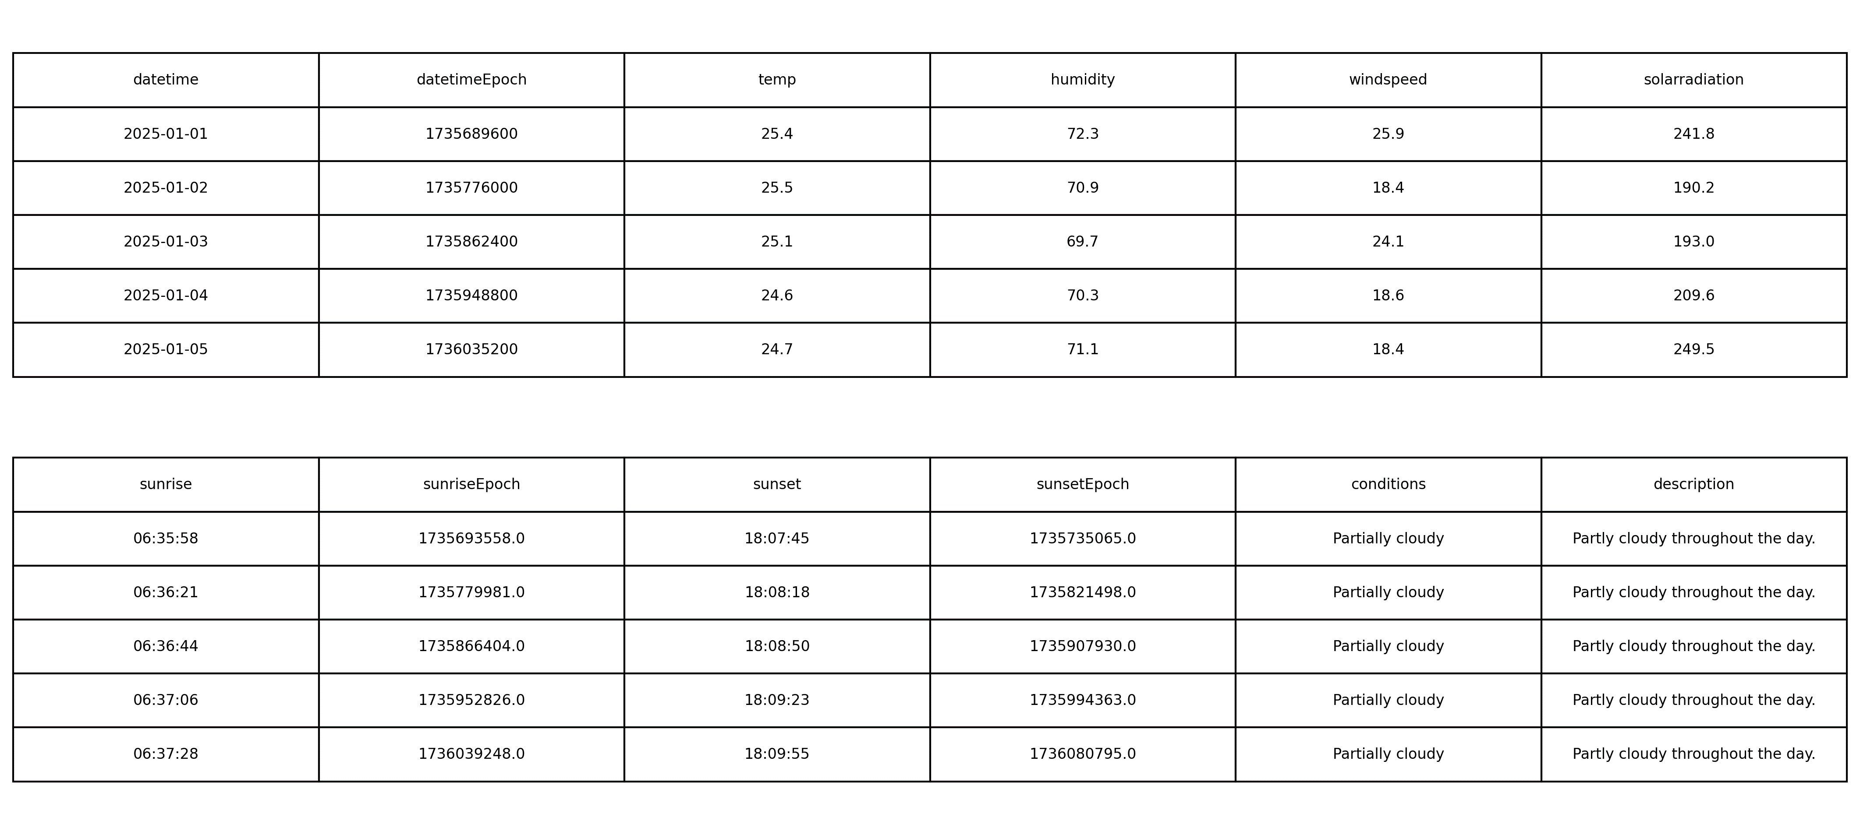
Demonstration
Environmental Dataset Processing
Environmental data collected from the Dindigul weather dataset is used as the initial input for the system.
The dataset includes parameters such as temperature, humidity, wind speed, and solar radiation.
These environmental variables are processed through the data processing pipeline to generate standardized greenhouse environmental parameters.
Fig. Extract of the Dindigul Weather Dataset

Slide 15
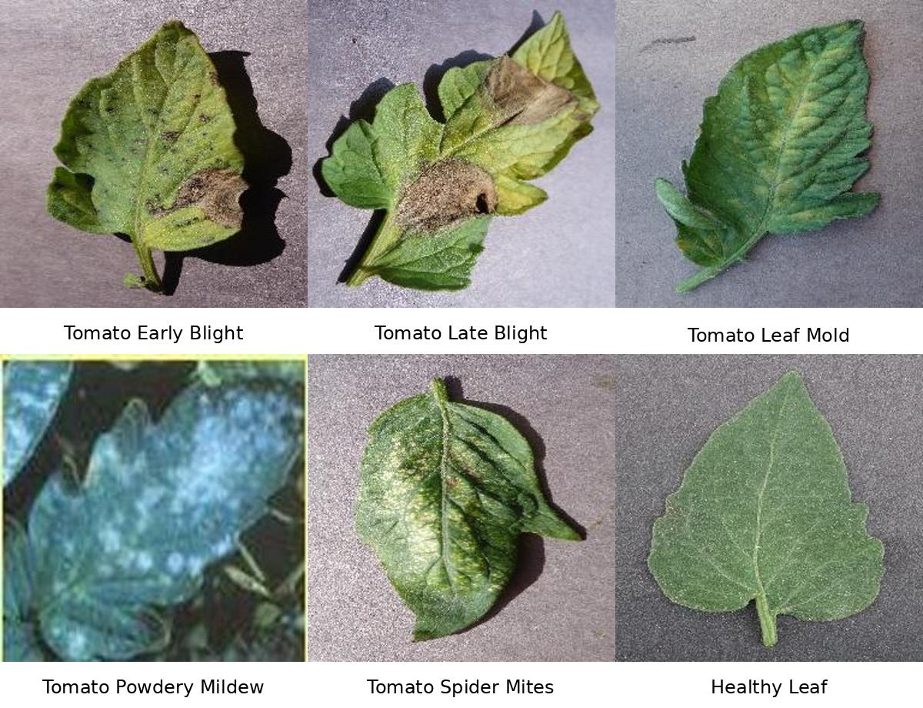
Demonstration (Contd..)
Plant Disease Dataset
Tomato leaf images are used to train the plant disease detection model.
The dataset contains samples representing healthy leaves and different tomato leaf diseases.
The deep learning model learns visual disease patterns for accurate disease classification.
Fig. Tomato Leaf Disease Classification Dataset Samples

Slide 16
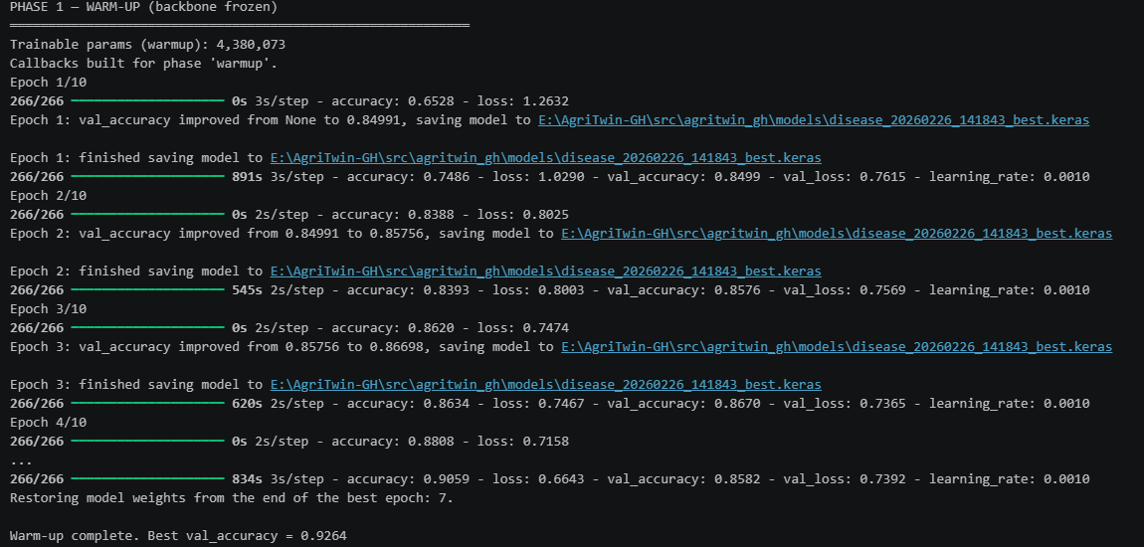
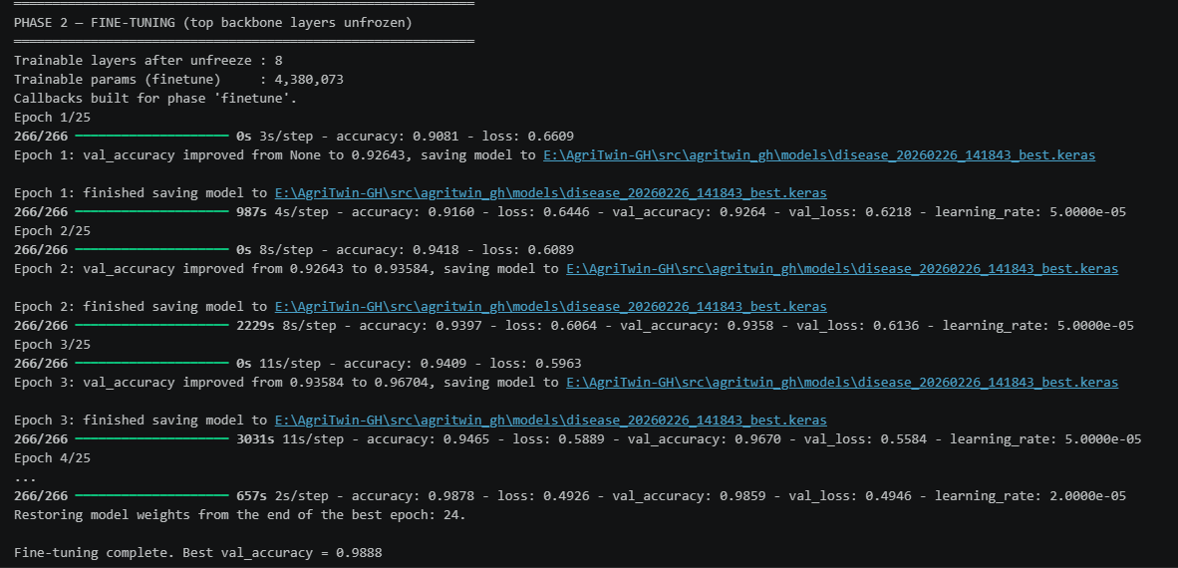
Demonstration (Contd..)
Disease Detection Model Training
The model is trained using EfficientNetB0 with transfer learning.
Training is performed in two stages to improve performance.
Phase-1 (Warm-Up):
Only the newly added classification layers are trained.
The EfficientNet backbone remains frozen.
Phase-2 (Fine-Tuning):
Selected backbone layers are unfrozen.
The network adapts to tomato leaf disease features.
Fig. Phase-1 Warm-Up Training Results for Disease Classification Model
Fig. Phase-2 Fine-Tuning Results for Disease Classification Model

Slide 17
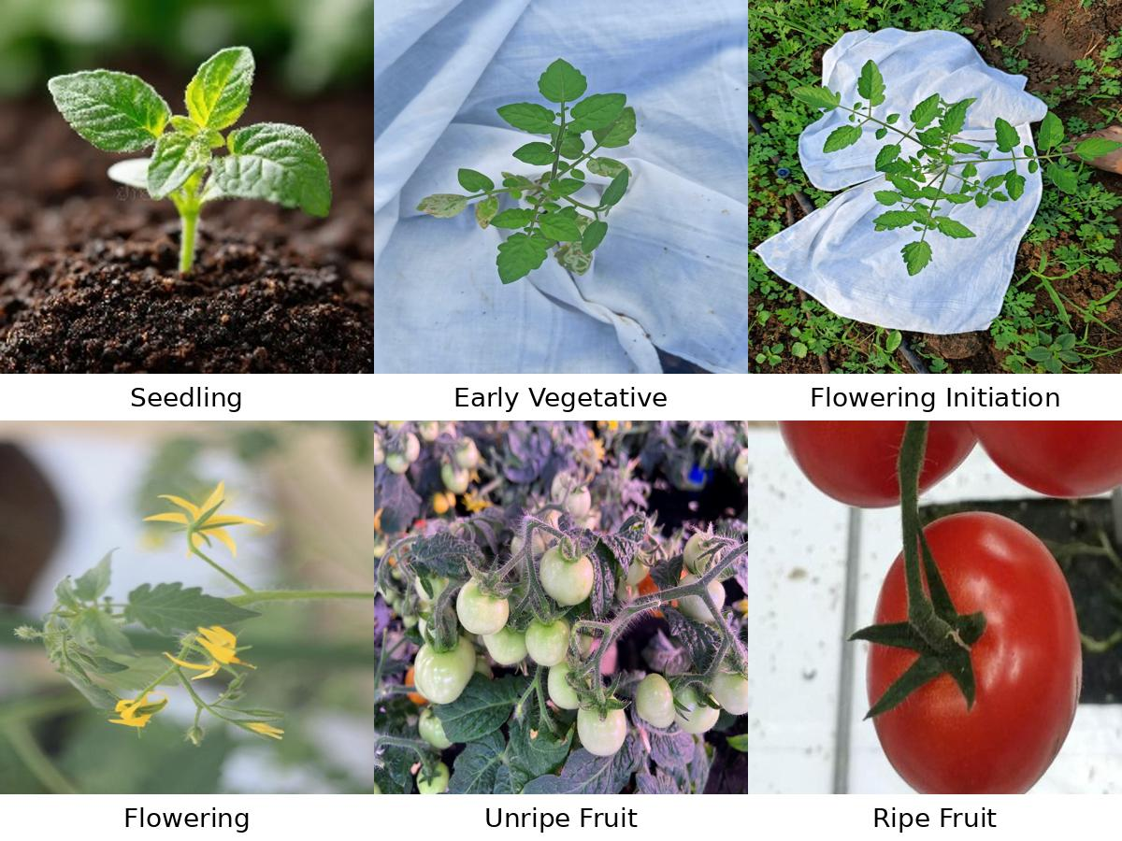
Demonstration (Contd..)
Crop Growth Stage Dataset
The tomato plant dataset contains images representing different stages of plant development.
These images are used to train the growth stage classification model.
Fig. Tomato Crop Growth Stages Dataset Samples

Slide 18
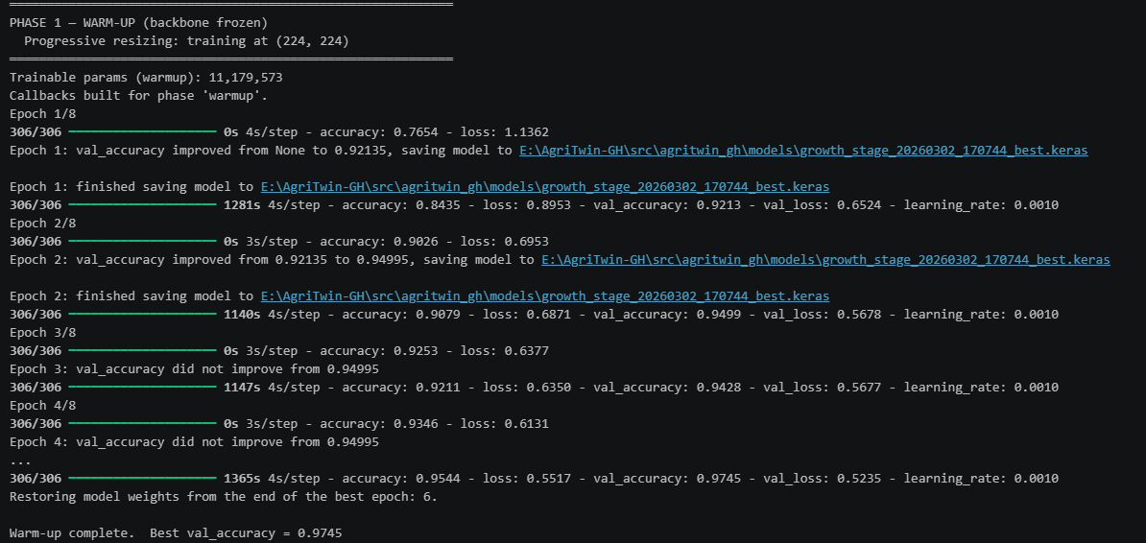
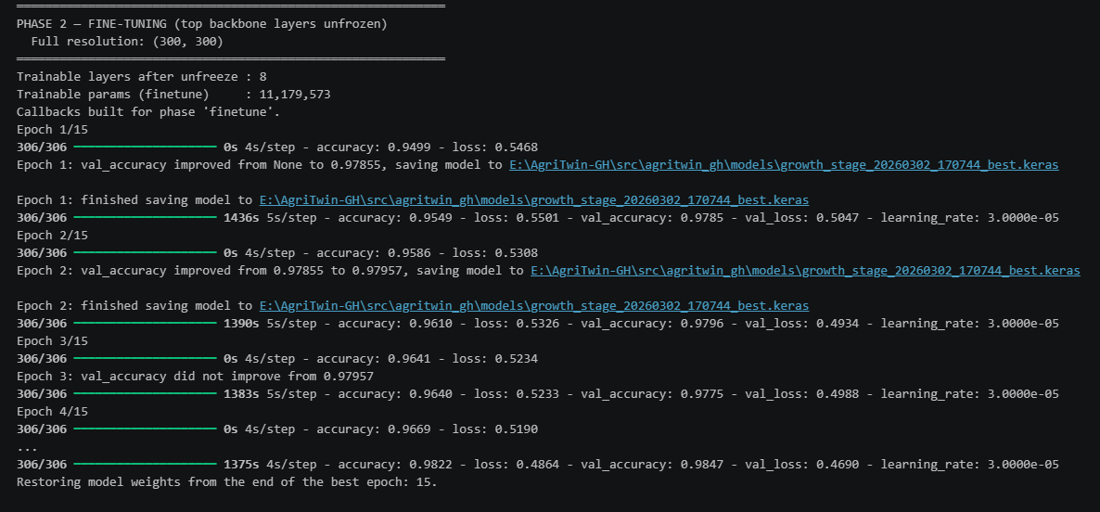
Demonstration (Contd..)
Growth Stage Classification Training
The tomato growth stage classification model uses EfficientNetB3 architecture.
Training follows the same two-phase strategy.
Phase-1 (Warm-Up):
Only the newly added classification layers are trained.
The EfficientNet backbone remains frozen.
Phase-2 (Fine-Tuning):
Selected backbone layers are unfrozen.
The network adapts to tomato leaf disease features.
Fig. Phase-1 Warm-Up Training Results for Growth Stage Classification Model
Fig. Phase-2 Fine-Tuning Results for Growth Stage Classification Model

Slide 19
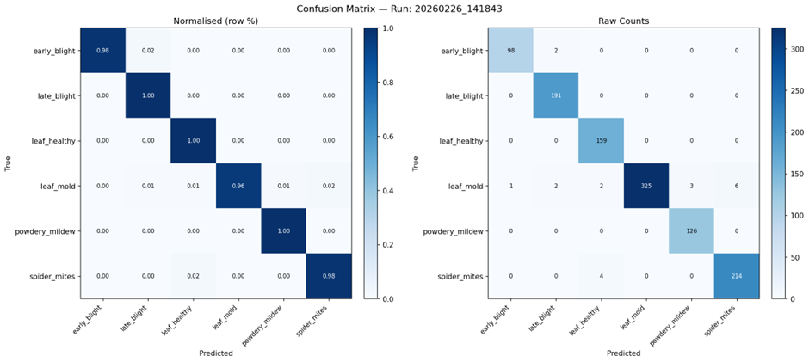
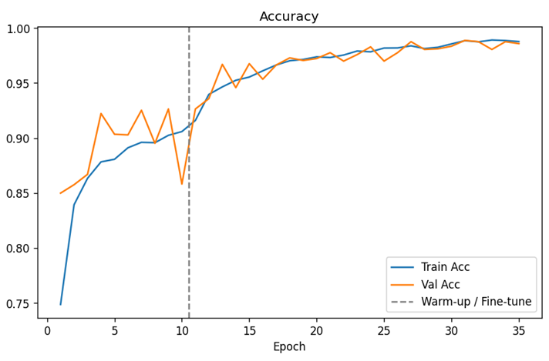
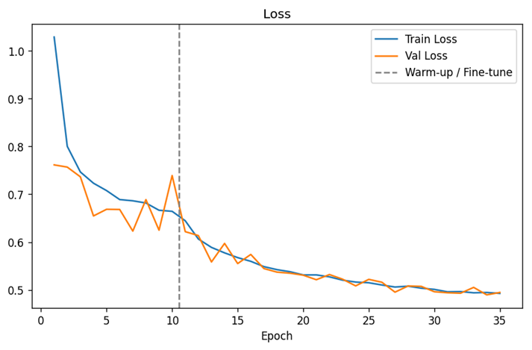
Results and Performance
Disease Detection Model Evaluation
The confusion matrix shows classification accuracy across different tomato leaf disease categories.
Training accuracy graph demonstrates progressive improvement in model performance.
Training loss graph confirms stable convergence during model training.
These results indicate that the model can accurately identify disease patterns in tomato leaves.
Fig. Confusion Matrix of Tomato Disease Detection Model
Fig. Training Accuracy of the Disease Detection Model
Fig. Training Loss of the Disease Detection Model

Slide 20
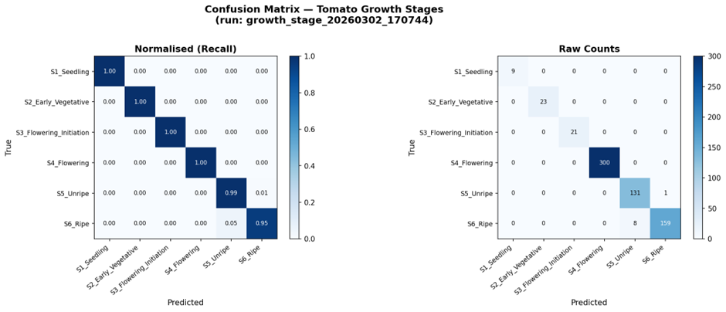
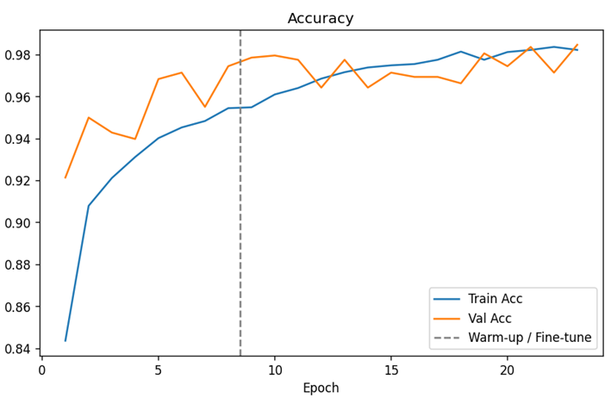
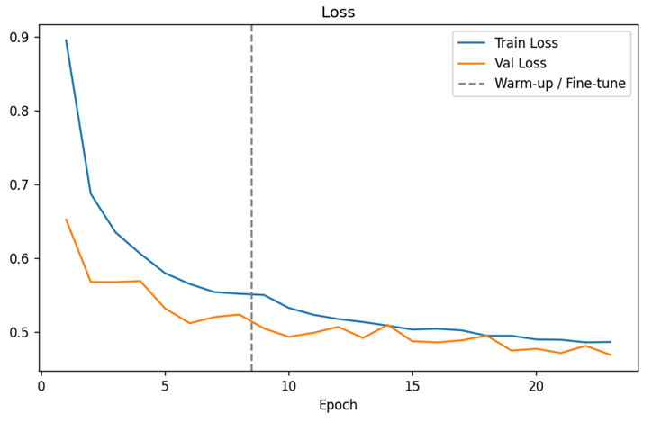
Results and Performance (Contd..)
Growth Stage Classification Evaluation
The confusion matrix shows classification accuracy across different tomato leaf disease categories.
Training accuracy graph demonstrates progressive improvement in model performance.
Training loss graph confirms stable convergence during model training.
These results indicate that the model can accurately identify disease patterns in tomato leaves.
Fig. Confusion Matrix of Tomato Growth Stage Classification Model
Fig. Training Accuracy of the Growth Stage Classification Model
Fig. Training Loss of the Growth Stage Classification Model

Slide 21
Conclusion
The proposed AgriTwin-GH system introduces an intelligent framework for smart greenhouse monitoring and crop analysis.
The system architecture is designed using modular decomposition, ensuring clear separation between data processing, predictive analytics, and digital twin–based greenhouse control.
Each module and its corresponding tasks were explicitly defined and structured, providing a clear understanding of the internal workflow and system responsibilities.
Overall, the system establishes a strong foundation for intelligent greenhouse monitoring and supports the future development of AI-driven greenhouse management systems focused on productivity, sustainability, and resource efficiency.

Slide 22
Datasets
PlantVillage Dataset – Kaggle
URL: https://www.kaggle.com/datasets/arjuntejaswi/plant-village
Ripe and Unripe Tomatoes Dataset – Kaggle
URL: https://www.kaggle.com/datasets/adilshamim8/greenhouse-plant-growth-metrics
Tomato Disease Dataset – Mendeley Data
URL: https://data.mendeley.com/datasets/c2x8rynybg/1
Tomato-flower-3-class Dataset – Kaggle
URL: https://www.kaggle.com/datasets/jawadulkarim117/tomato-flower-3-class
TomatoPlantfactoryDataset – Mendeley Data
URL: https://data.mendeley.com/datasets/8h3s6jkyff/1
Tomato Plant Stages Dataset – Kaggle
URL: https://www.kaggle.com/datasets/arjunsudheer326/tomato-plant-stages-dataset

Slide 23
References
[1] E. Elbasi, N. Mostafa, C. Zaki, Z. AlArnaout, A. E. Topcu, and L. Saker, “Optimizing agricultural data analysis techniques through AI-powered decision-making processes,” Applied Sciences, vol. 14, no. 8018, 2024.
[2] M. Ghiasi, Z. Wang, M. Mehrandezh, and A. Mohammadi, “Optimal strategy for energy-efficient management of greenhouse climate control,” IEEE Open Access Journal of Power and Energy, vol. 12, pp. 1–14, Dec. 2025.
[3] D. A. Howard, Z. Ma, C. Veje, A. Clausen, J. M. Aaslyng, and B. N. Jørgensen, “Greenhouse industry 4.0 – digital twin technology for commercial greenhouses,” Energy Informatics, vol. 4, no. 1, pp. 1–20, May 2021.
[4] Y. Huo, Y. Liu, P. He, L. Hu, W. Gao, and L. Gu, “Identifying tomato growth stages in protected agriculture with StyleGAN3–synthetic images and Vision Transformer,” Agriculture, vol. 15, no. 120, 2025.
[5] D. S. Joseph, P. M. Pawar, and K. Chakradeo, “Real-time plant disease dataset development and detection of plant disease using deep learning,” IEEE Access, vol. 11, pp. 1–15, 2023.
[6] A. Kaur and R. Kaur, “AI-enabled energy management for sustainable smart greenhouses: An integrated review,” Journal of Cleaner Production, vol. 382, pp. 1–15, 2024.
[7] D. K. Lee, B. K. Kang, Y. J. Kim, T. G. An, and Y. T. Chae, “A digital twin-based framework for precision tomato cultivation: Integrating XGBoost-based prediction with model predictive control,” SSRN Electronic Journal, 2024.

Slide 24
References (Contd..)
[8] S. R. Luna, M. P. García, and J. R. Torres, “Digital twin technology in greenhouse-based precision agriculture,” Computers and Electronics in Agriculture, vol. 209, pp. 107–119, 2023.
[9] B. V. Nikitha, N. K. S. Keerthan, P. Praneeth, and T. Amrita, “Leaf disease detection and classification,” Procedia Computer Science, vol. 218, pp. 291–300, Jan. 2023.
[10] A. Oad, S. S. Abbas, A. Zafar, et al., “Plant leaf disease detection using ensemble learning and explainable AI,” IEEE Access, vol. 12, pp. 156038–156052, 2024.
[11] A. Soussi, E. Zero, C. D. C. Herrera, et al., “Integrating digital twins and model predictive control for sustainable greenhouse management in smart agriculture,” IEEE Transactions on AgriFood Electronics, vol. 1, no. 1, pp. 1–17, 2025.
[12] A. F. Subahi and K. E. Bouazza, “An intelligent IoT-based system design for controlling and monitoring greenhouse temperature,” IEEE Access, vol. 10, pp. 1–12, 2022.
[13] R. A. Tathed, “Designing AI-driven platforms to transform agricultural ecosystems,” International Journal for Research Publication and Seminar, vol. 16, no. 2, pp. 249–268, Apr.–Jun. 2025.
[14] M. Umar, S. Altaf, S. Ahmad, H. Mahmoud, A. S. N. Mohamed, and R. Ayub, “Precision agriculture through deep learning: Tomato plant multiple diseases recognition with CNN and improved YOLOv7,” IEEE Access, vol. 12, pp. 49167–49180, Apr. 2024.

Slide 25
Thank you

